Slide 1


Capstone Project - 3
Mobile Price Range Prediction
Sujit Musale
(Self Project)

Slide 2
About Mobile Price Prediction …….
I have implemented a Mobile Price Prediction using different Machine Learning Algorithms.
In the competitive mobile phone market companies want to understand sales data of mobile phones and factors which drive the prices.
Deciding on the correct price of a product is very important for the market success of a product.
Mobile phones come in all sorts of prices, features, specifications and all .This project will classify the price range of the mobile price.
A new product that has to be launched, must have the correct price so that consumers find it appropriate to buy the product.

Slide 3
Problem statement…..
In the competitive mobile phone market companies want to understand sales data of mobile phones and factors which drive the prices.
The objective is to find out some relation between features of a mobile phone(eg:- RAM, Internal Memory, etc) and its selling price.
In this problem, we do not have to predict the actual price but a price range indicating how high the price is.

Slide 4
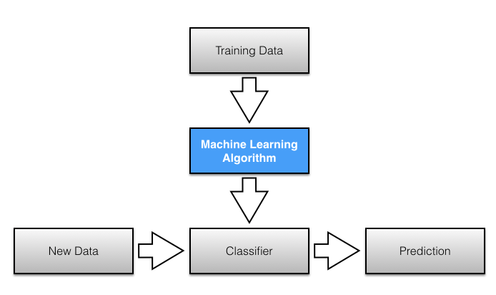
Project Process flow …..

Slide 5
variable’s Details …..
Battery_power - Total energy a battery can store in one time measured in mAh
Blue - Has bluetooth or not
Clock_speed - speed at which microprocessor executes instructions
Dual_sim - Has dual sim support or not
Fc - Front Camera mega pixels
Four_g - Has 4G or not
Int_memory - Internal Memory in Gigabytes
M_dep - Mobile Depth in cm
Mobile_wt - Weight of mobile phone
N_cores - Number of cores of processor
Pc - Primary Camera mega pixels
Px_height - Pixel Resolution Height
Px_width - Pixel Resolution Width
Ram - Random Access Memory in Mega Bytes
Sc_h - Screen Height of mobile in cm
Sc_w - Screen Width of mobile in cm
Talk_time - longest time that a single battery charge will last when you are
Three_g - Has 3G or not
Touch_screen - Has touch screen or not
Wifi - Has wifi or not
Price_range - This is the target variable with value of 0(low cost), 1(medium cost), 2(high cost) and 3(very high cost)

Slide 6
Loading & Data Cleaning….
Given data set having 2000 Rows and 21coloums.
Whole data present in numeric varaible and also there is no any null value is the given data.
we can see that sc_w and px_height has minimum value 0. it is not possible that mobile with 0 screen width and pixcel with 0 height.
So, px_height and sc_w are having 2 and 180 numbers of zero value respectively. as px_height is just having 2 values as zero we can drop that rows easily. and for sc_w we use Nearest Neighbour Imputations as Missing values are imputed using the k-Nearest Neighbors approach where a Euclidean distance is used to find the nearest neighbors.

Slide 7
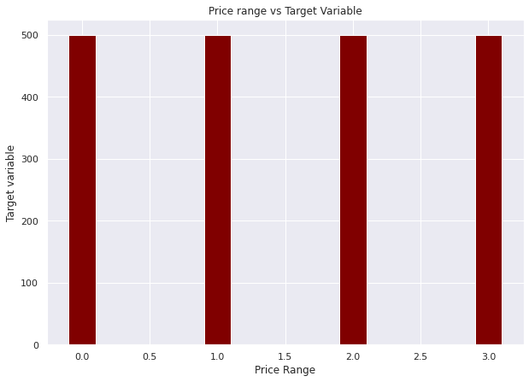
EDA ….
“Here we can see that there
is no in-balanced in target variable
.. as all values counts are almost
Equal”
0- low cost
1- medium cost
2- high cost
3- very high cost

Slide 8
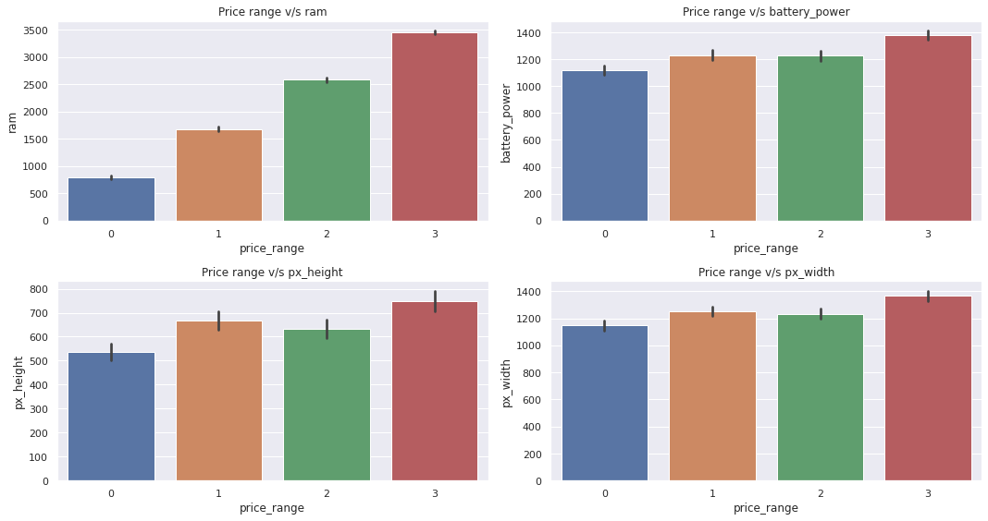
EDA (continued…..)
we can see that from 1st graph that as Ram size increases price also increase so we can say that they are having positive correlation is exist between two variable.
Also, in 2nd graph battery power and price having positive relation between them.
for Pixal height and pixel width also having positive relation but for price range 1 and 2 you can see pixal height and pixel width are not having any significant impact on mobile price.

Slide 9
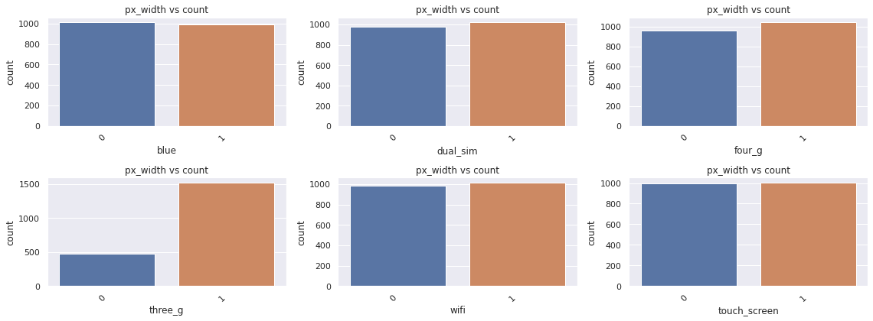
EDA (continued…..)
Here we can see that 1 means mobile has that specification and 0 means that specification is not available for that mobile.
here most of all binary variables are having 50% of the feature except three_g almost 25% features are not having three_g and 75% are having three_g.

Slide 10
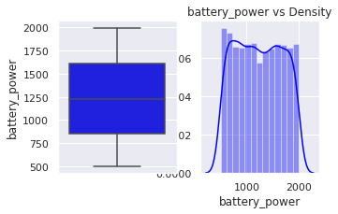
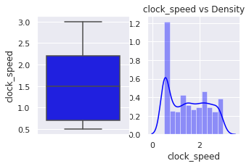
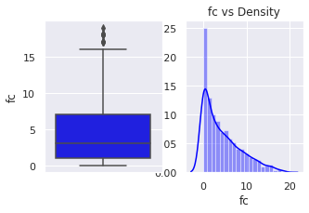
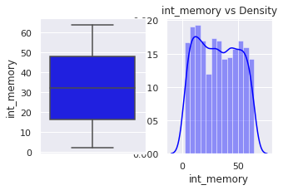
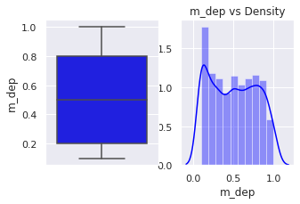
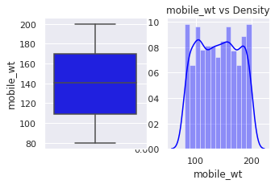
EDA (continued…..)
Normal Distribution and Box plot-

Slide 11
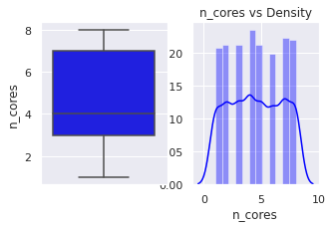
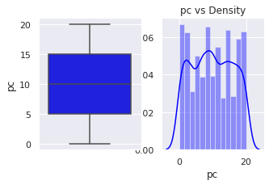
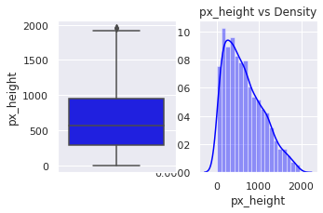
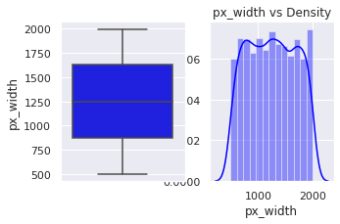
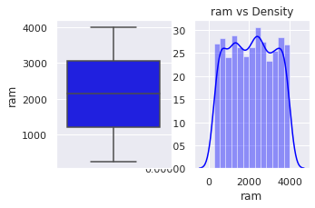
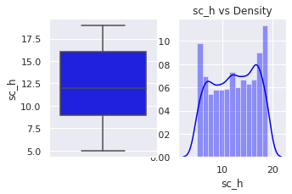
EDA (continued…..)
Normal Distribution and Box plot-

Slide 12
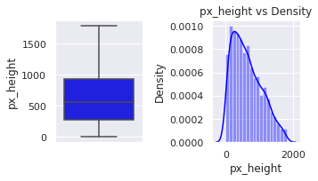
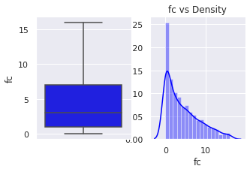
EDA (continued…..)
Outlier treatment-
Having outlier
Outlier Present

Slide 13
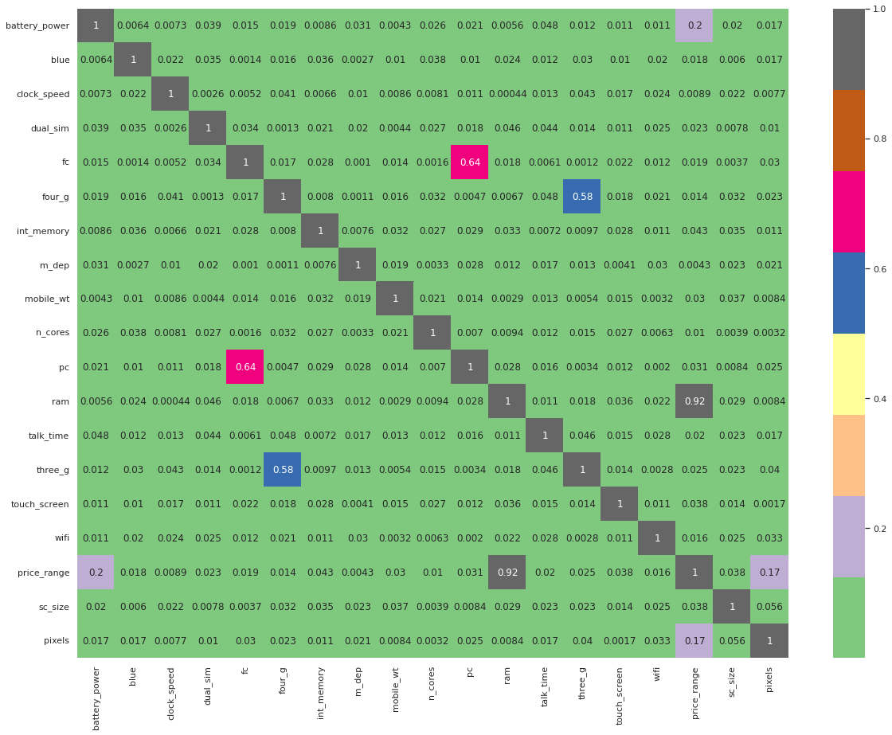
EDA (continued…..)
Correlation Plot

Slide 14
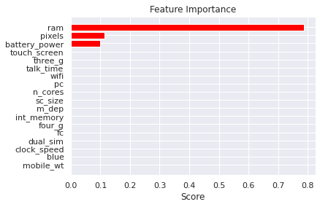
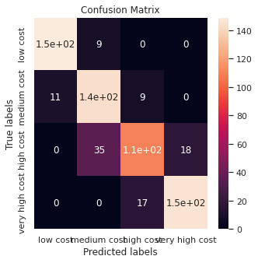
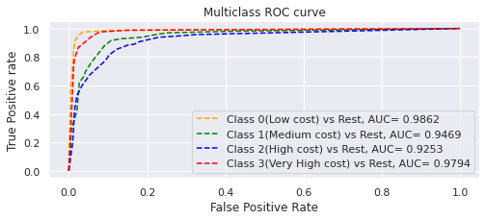
Model: 1. Decision Tree
Accuracy score of train set | Accuracy score of test set
0.8797564687975646 | 0.8472222222222222

Slide 15
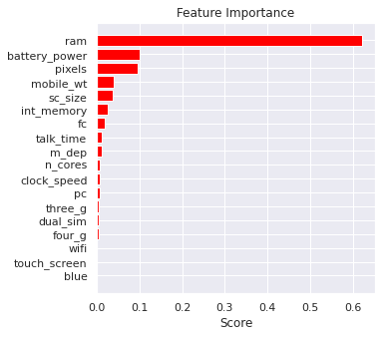
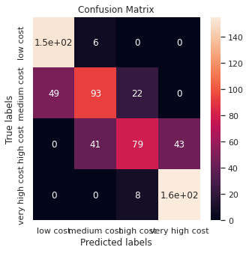
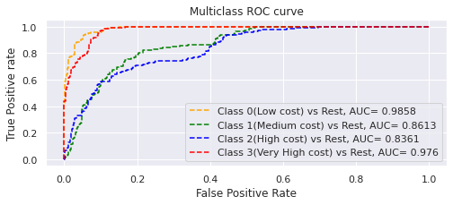
Model: 2. Random Forest classifier
Accuracy score of train set | Accuracy score of test set
0.7929984779299848 | 0.7391975308641975

Slide 16
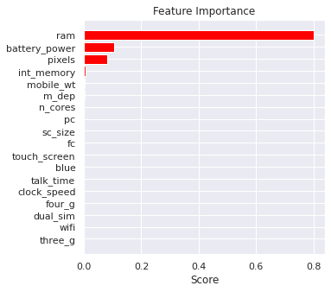
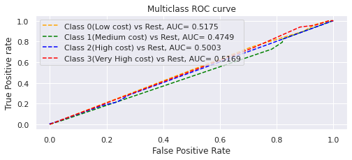
Model: 3. Gradient Boosting Classifier
Accuracy score of train set | Accuracy score of test set
0.9771689497716894 | 0.8780864197530864

Slide 17
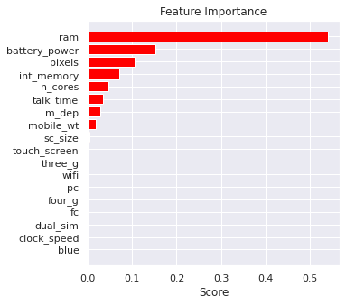
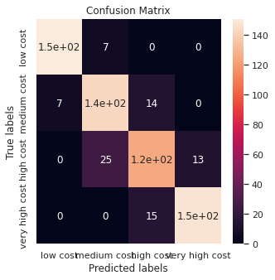
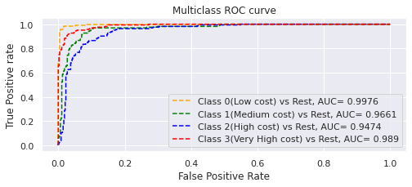
Model: 4. XGboost classifier
.
Accuracy score of train set | Accuracy score of test set
0.9345509893455098 | 0.875

Slide 18
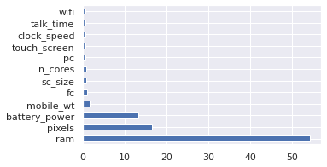
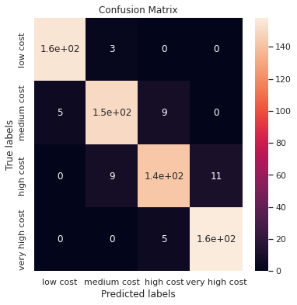
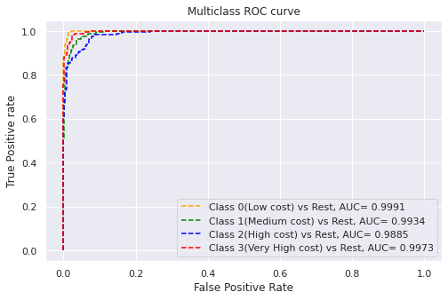
Model: 5. SVM
Accuracy score of train set | Accuracy score of test set
0.9345509893455098 | 0.875

Slide 19
Conclusion
as we can see from all above model are having good accuracy score and AUC score too. But the top most model is SVM model giving accuracy 94.42 and 93.51 for train and test data respectively after hyper parameter tuning . in each and every model top feature is ram so this feature is most important feature.

Slide 20
Thanks

